Slide 1







DOIT
AI Productivity and Mental Stability app

Slide 2




PROJECT OVERVIEW
an AI-integrated web app that acts as a virtual emotional support friend and
productivity assistant.
Functionality:
AI chatbot for conversations and discussions, getting support and motivation
Automatic smart to-do list with minimal input
Includes a calendar, notifications, daily check-ins, and a Pomodoro timer with calming sounds

Slide 3
TECHNOLOGIES
Frontend: HTML5, CSS3, JavaScript
Chatbot: Anthropic’s Claude API
AI Logic: JavaScript-based prompts
Calendar UI: Custom JS calendar
Notifications: Web Notifications API
Timer UI: Custom JS Pomodoro
Database: Firebase

Slide 4
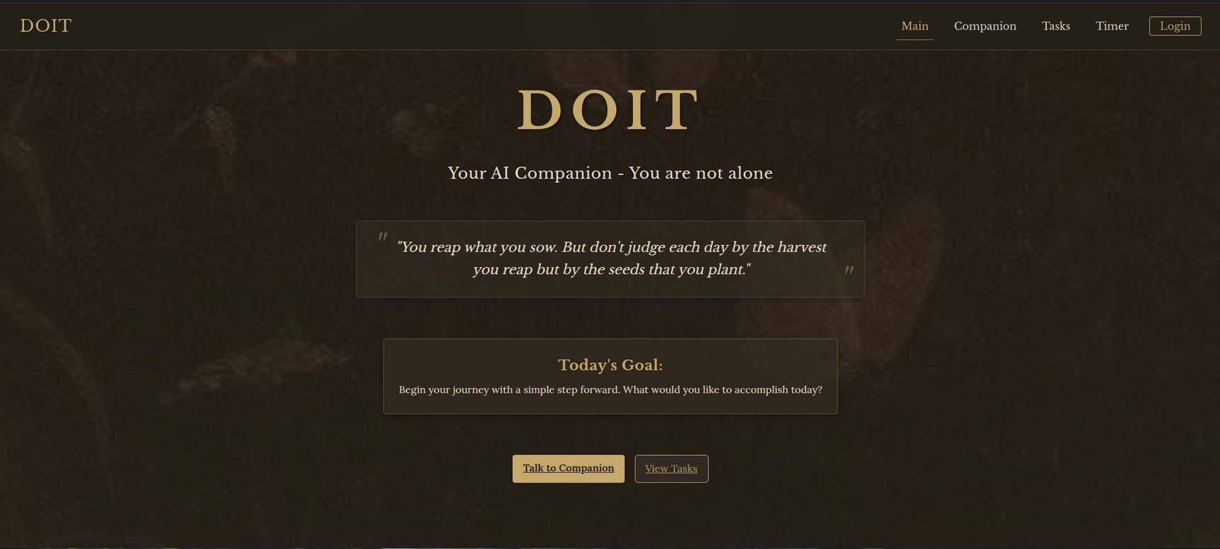
DESIGN

Slide 5
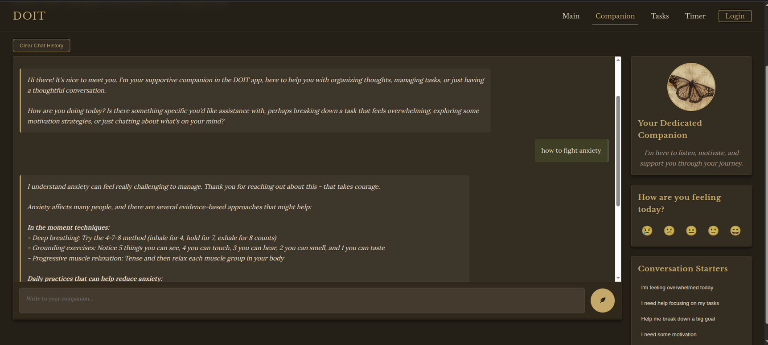
DESIGN

Slide 6
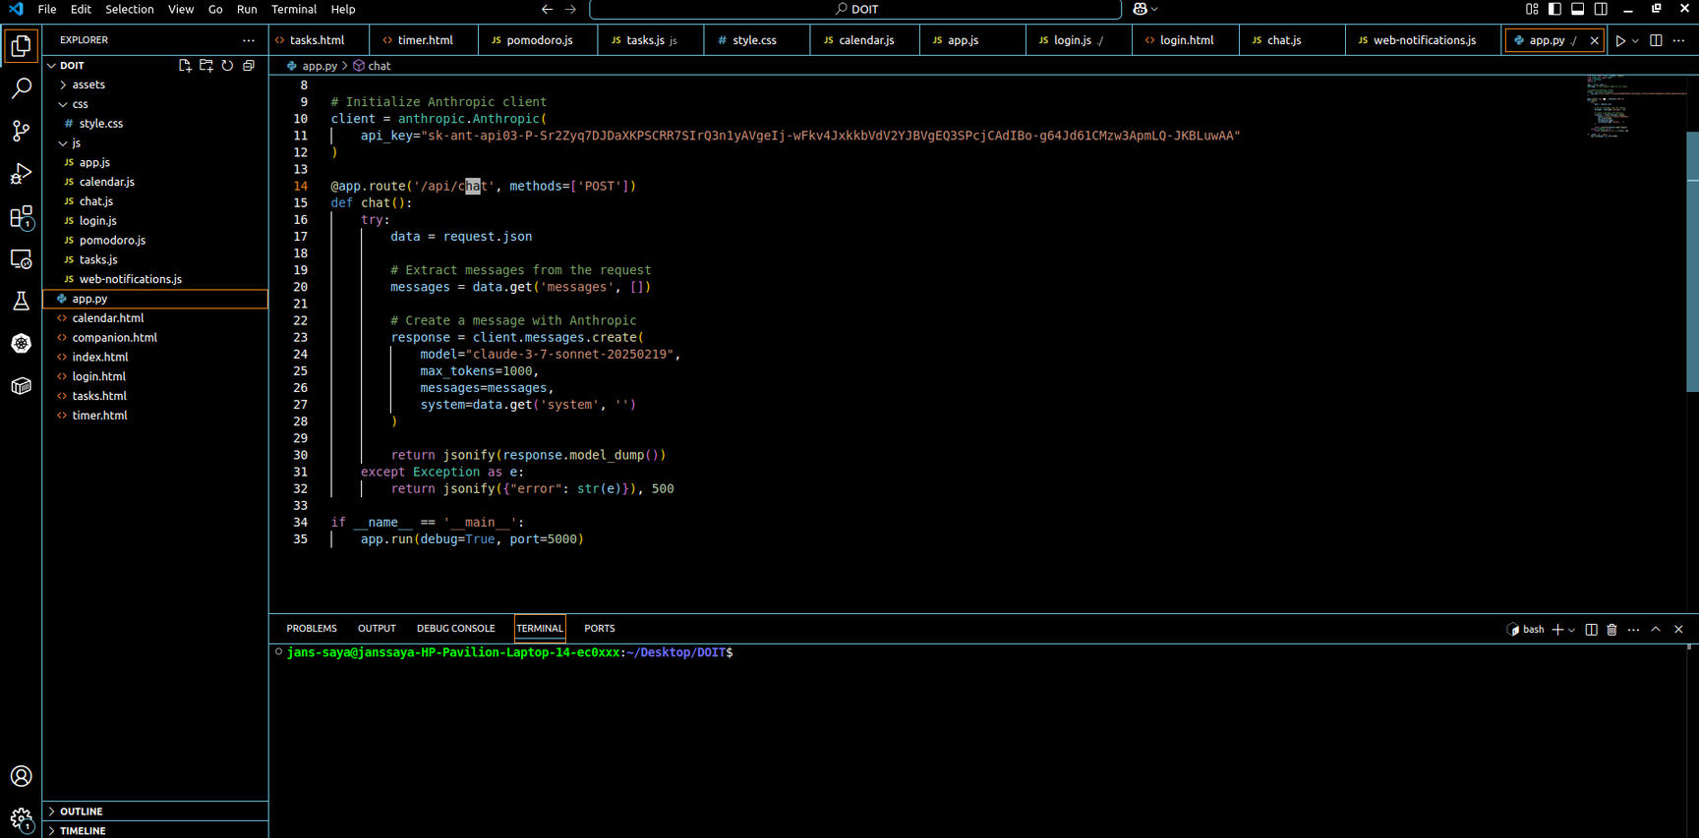
CODE

Slide 7
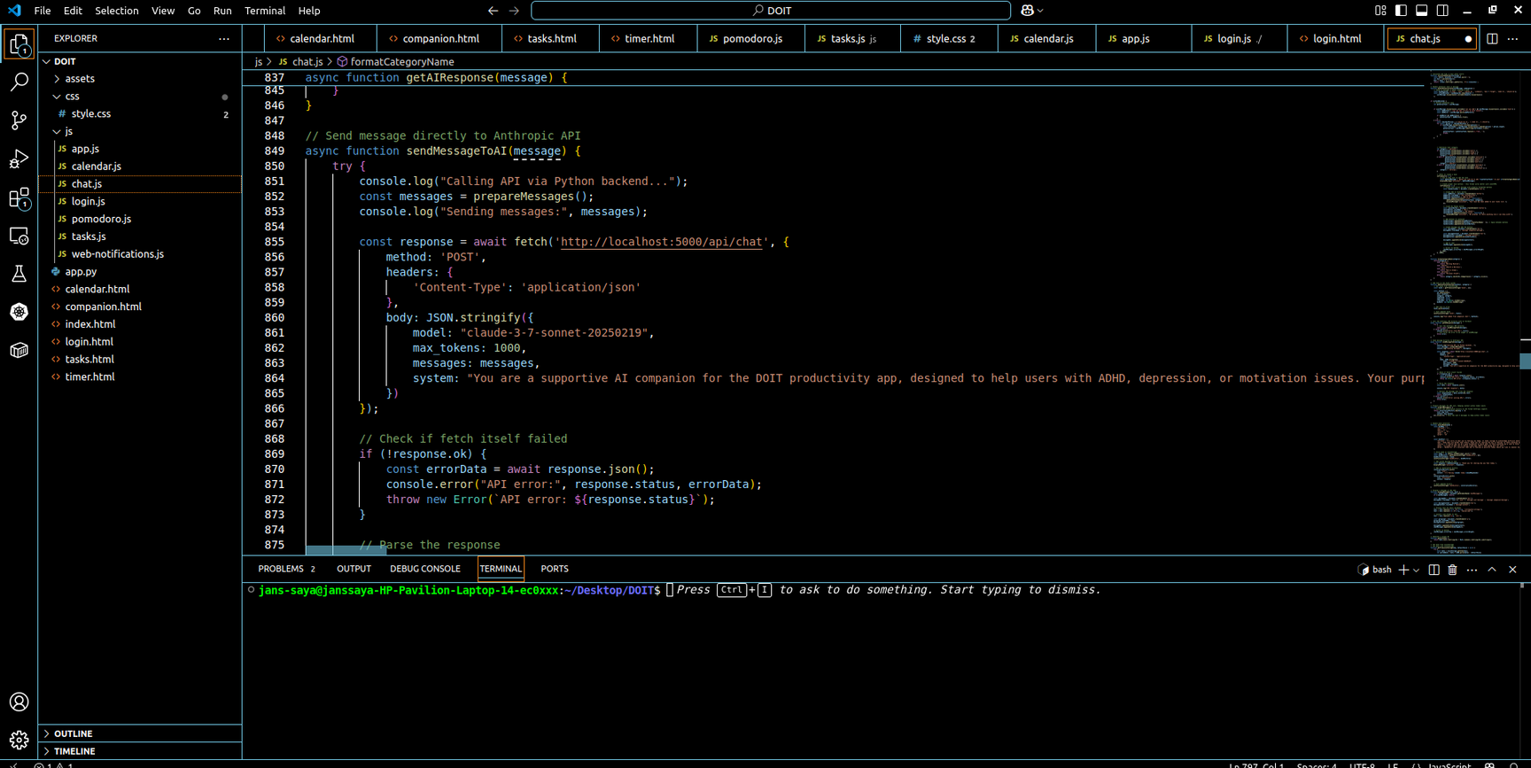
CODE

Slide 8
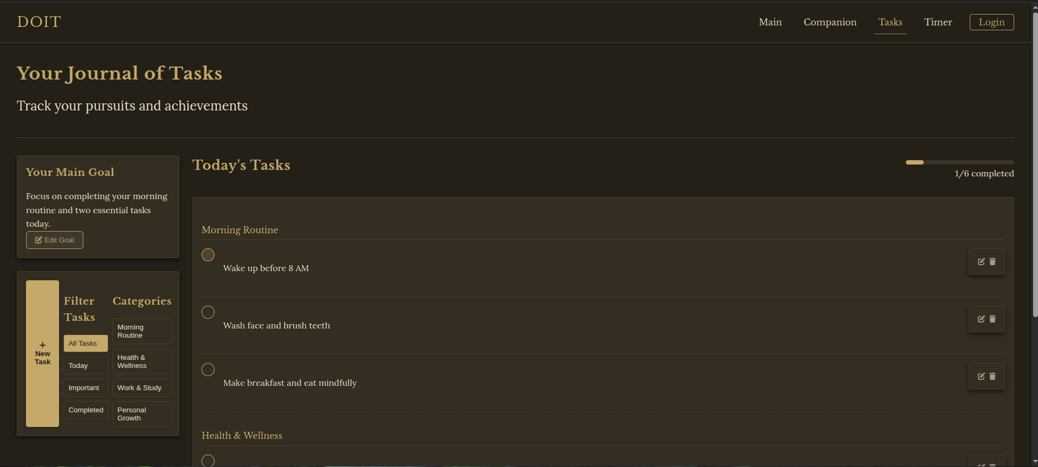
DESIGN

Slide 9
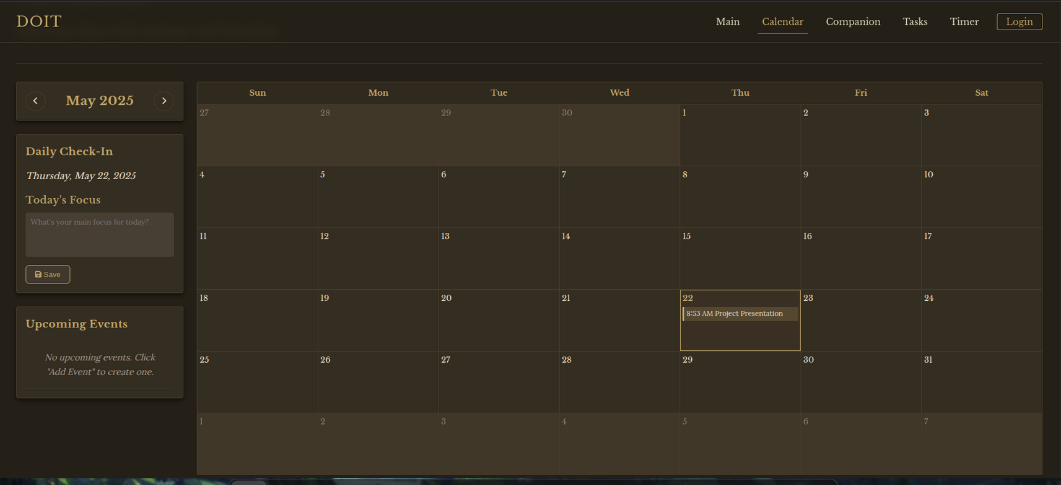
DESIGN

Slide 10
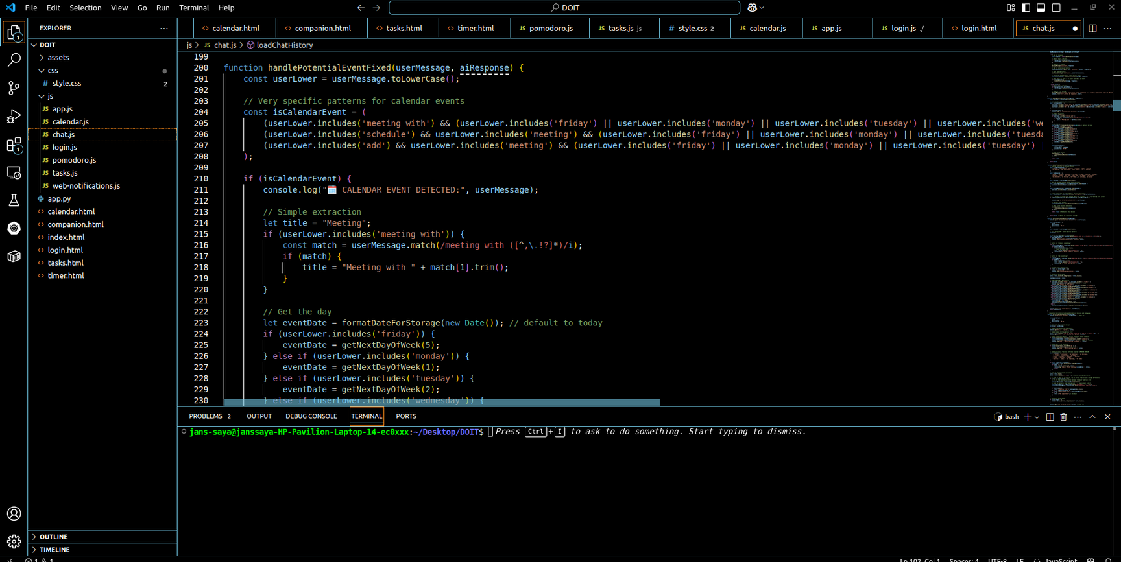
CODE

Slide 11
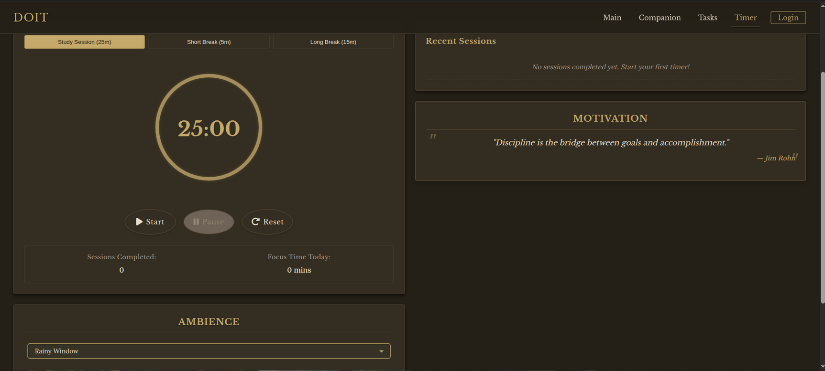
DESIGN

Slide 12
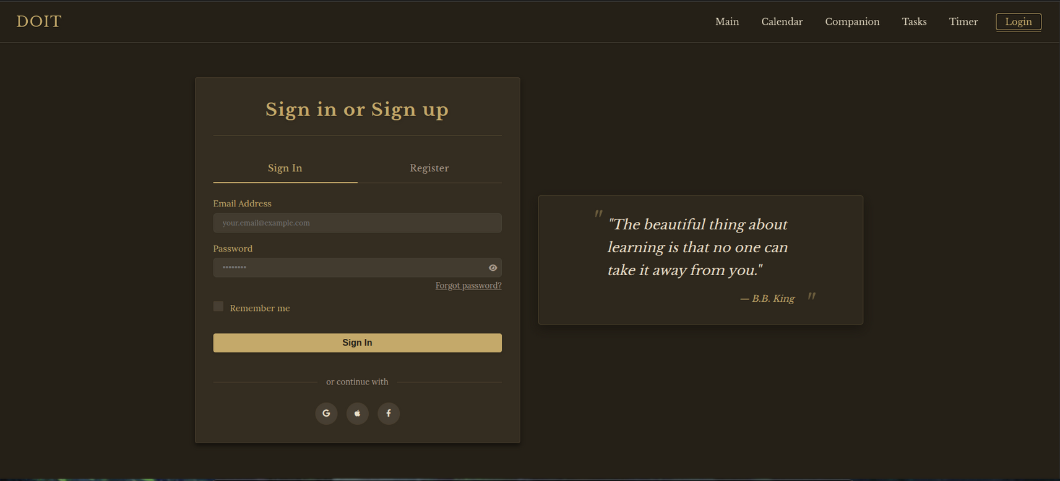
DESIGN

Slide 13

THANK YOU

